Slide 1

Introduction to Machine Learning and Web Scraping
Session 3, 19th Sep 2020

Slide 2

Agenda
Can we browse a web page programmatically?
What the heck is Machine Learning?
Can’t we just write an algorithm? Why do we need data?
Is detecting Cat/Dog different from predicting new stock price tomorrow?

Slide 3
Let’s Brush Python

Slide 4

Basics
Syntax
Comments
Variables
Data Types
Operators
Loops
Conditions
Functions Resource: w3schools

Slide 5
Numpy
Numpy is the core library for scientific computing in Python. It provides a high-performance multidimensional array object, and tools for working with these arrays. A numpy array is a grid of values, all of the same type, and is indexed by a tuple of nonnegative integers. The number of dimensions is the rank of the array; the shape of an array is a tuple of integers giving the size of the array along each dimension.
The Python core library provided Lists. A list is the Python equivalent of an array, but is resizeable and can contain elements of different types.

Slide 6
Numpy
A common beginner question is what is the real difference here. The answer is performance. Numpy data structures perform better in:
Size - Numpy data structures take up less space
Performance - they have a need for speed and are faster than lists
Functionality - SciPy and NumPy have optimized functions such as linear algebra operations built in.

Slide 7
Pandas
A dict is to a DataFrame as a bicycle is to a car. You can pedal 10 feet on a bicycle faster than you can start a car, get it in gear, etc, etc. But if you need to go a mile, the car wins.
For certain small, targeted purposes, a dict may be faster. And if that is all you need, then use a dict, for sure! But if you need/want the power and luxury of a DataFrame, then a dict is no substitute. It is meaningless to compare speed if the data structure does not first satisfy your needs.

Slide 8
Can we browse a web page programmatically?

Slide 9

Automating boring stuffs?
Web scraping is the process of extracting data on the web. With the right tools, anything that’s visible to you can be extracted

Slide 10

Use Cases
Price Comparison
Email Address Gathering
Social Media Scraping
Research and Development
Job Listings

Slide 11




Slide 12

What is a Web Page?

Slide 13
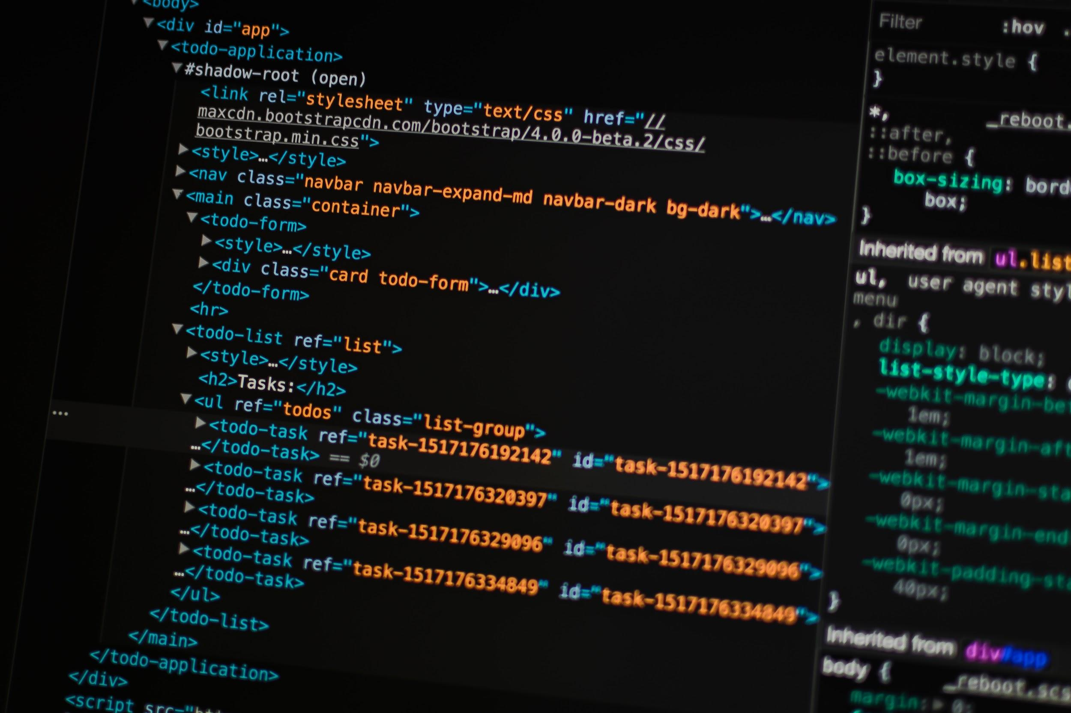
Notes:
A dict is to a DataFrame as a bicycle is to a car. You can pedal 10 feet on a bicycle faster than you can start a car, get it in gear, etc, etc. But if you need to go a mile, the car wins.
For certain small, targeted purposes, a dict may be faster. And if that is all you need, then use a dict, for sure! But if you need/want the power and luxury of a DataFrame, then a dict is no substitute. It is meaningless to compare speed if the data structure does not first satisfy your needs.

Slide 14
Demo
Let’s try to scrap some website

Slide 15

Machine Learning
What is Machine Learning?
What can we do with ML?
Types of ML
Common type of problem statements in ML
Popular Libraries

Slide 16
What is
Machine Learning?

Slide 17

Machine Learning is Magic!
How many of you wanted to be a magician?
Or at least do some magic?

Slide 18
Okay, I was kidding.
Machine Learning is Mathematics.
For me, Mathematics is magic.

Slide 19
How can computers learn from experience? Like we humans do?
→ We fail at many things. We say we’ve experienced something and try to not fail the next time.
→ Same goes with machines. And they have a lot of willpower, unlike me :D
→ They try for millions of times till they get things sorted out.

Slide 20
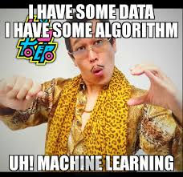
Where do machines get experience from?
One word.
DATA

Slide 21
What can we do with ML?
• Spam filtering
• Credit card fraud detection
• Digit recognition on checks, zip codes
• Detecting faces in images
• MRI image analysis
• Recommendation system
• Search engines
• Handwriting recognition
• Scene classification

Slide 22
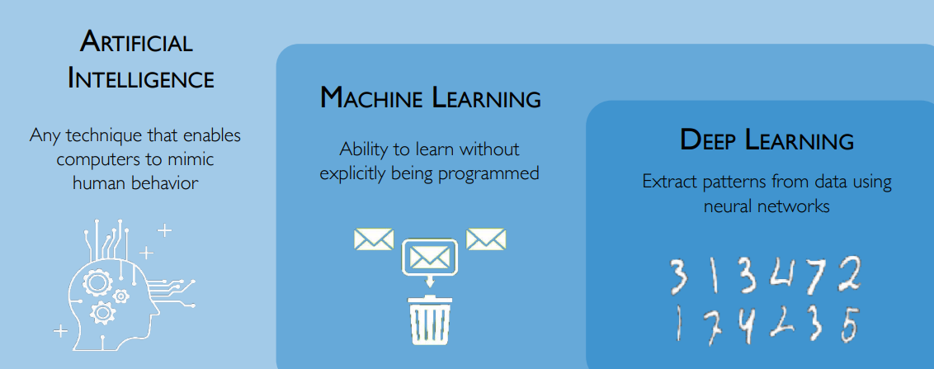
AI, ML & DL

Slide 23
Most of the ML problems are one of the following
→ Regression
→ Classification
→ Clustering

Slide 24
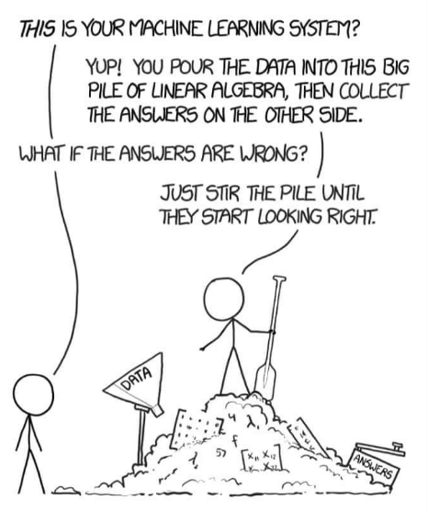
Types of Machine Learning
→ Supervised
→ Unsupervised
→ Reinforcement Learning
→ Semi Supervised

Slide 25
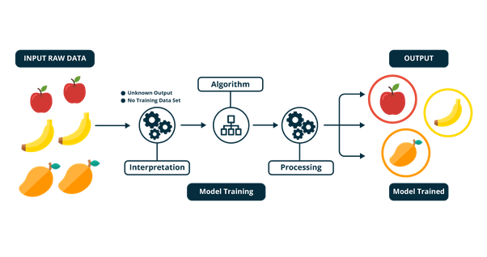
Supervised Learning
Supervised learning is the machine learning task of learning a function that maps an input to an output based on example input-output pairs.

Slide 26
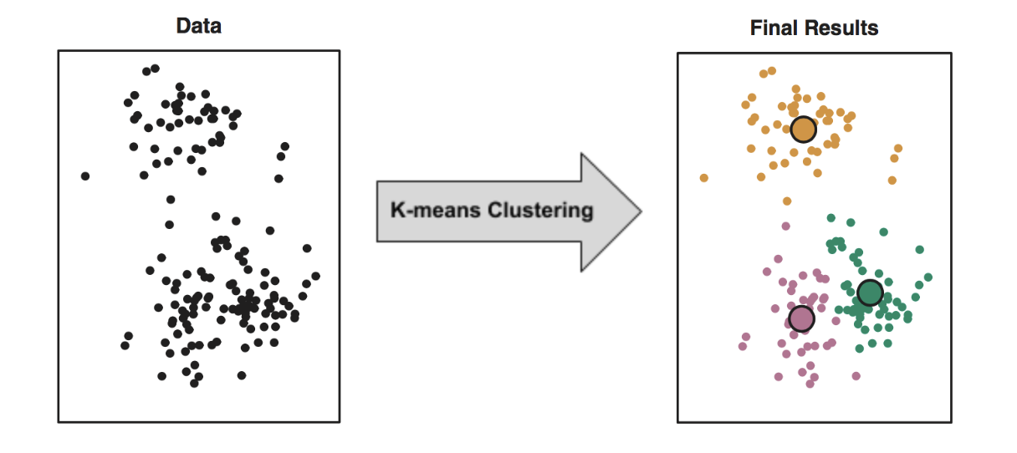
Unsupervised Learning
Unsupervised Learning is a class of Machine Learning techniques to find the patterns in data. The data given to unsupervised algorithm are not labelled, which means only the input variables(X) are given with no corresponding output variables.

Slide 27
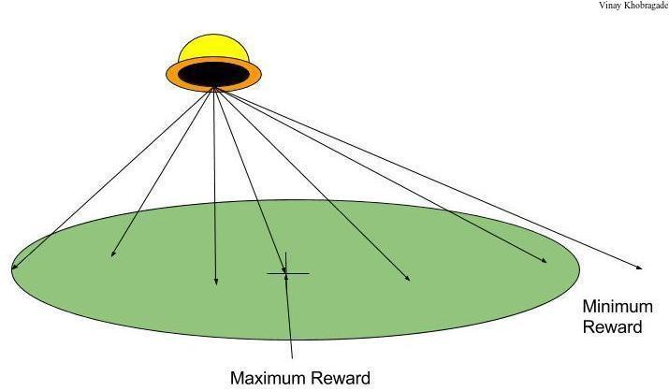
Reinforcement Learning
Reinforcement learning is about taking suitable action to maximize reward in a particular situation. It is employed by various software and machines to find the best possible behavior or path it should take in a specific situation.

Slide 28
Libraries

Slide 29
Libraries
numpy: Provides a fast numerical array structure and helper functions.
pandas: Provides a DataFrame structure to store data in memory and work with it easily and efficiently.
scikit-learn: The essential Machine Learning package in Python.
matplotlib: Basic plotting library in Python; most other Python plotting libraries are built on top of it.
seaborn: Advanced statistical plotting library.

Slide 30
Week Work

Slide 31
Week Work
Scrape books.toscrape.com and save the data to csv using pandas.
Note all the errors
Practice Numpy, Pandas
Read basic machine learning books, articles and create a glossary of terms
Participate in a kaggle competition, read available notebooks

